Slide 1
FLS_8 Case Study 01
Erica Brooks, Simi Augustine, David Camacho

Slide 2
Agenda
Overview
State summary
Missing data
ABV & IBU Analysis
Summary statistics
Correlations
conclusions

Slide 3
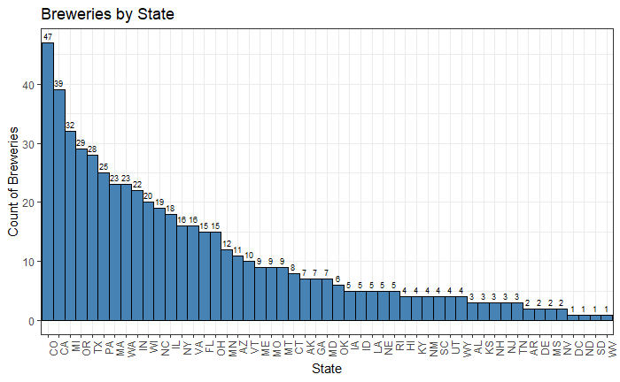
Breweries by state
State | Value
Colorado | Max
DC ND SD WV | Min
2 States | 30s
7 States | 20s
9 States | 10s
28 | < 9 (Excluding Mins)

Slide 4
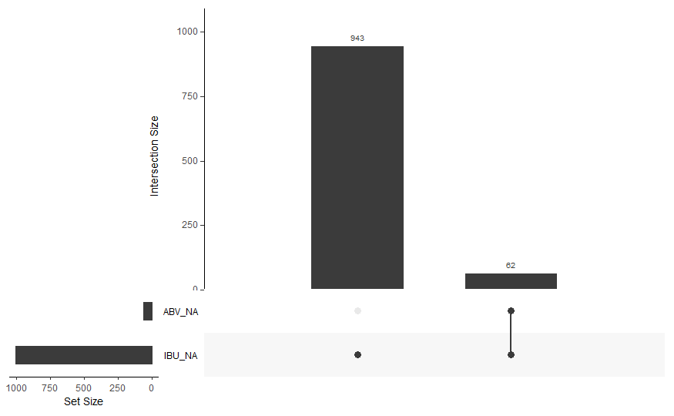
Missing Values (Intersections and Combinations)

Slide 5
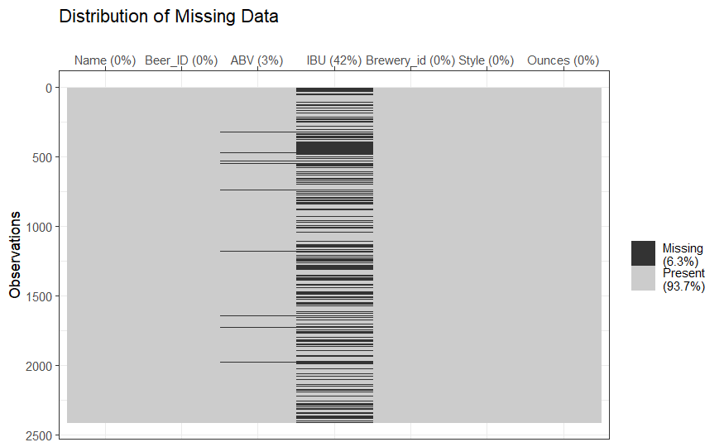
Missing Values (Distribution)

Slide 6
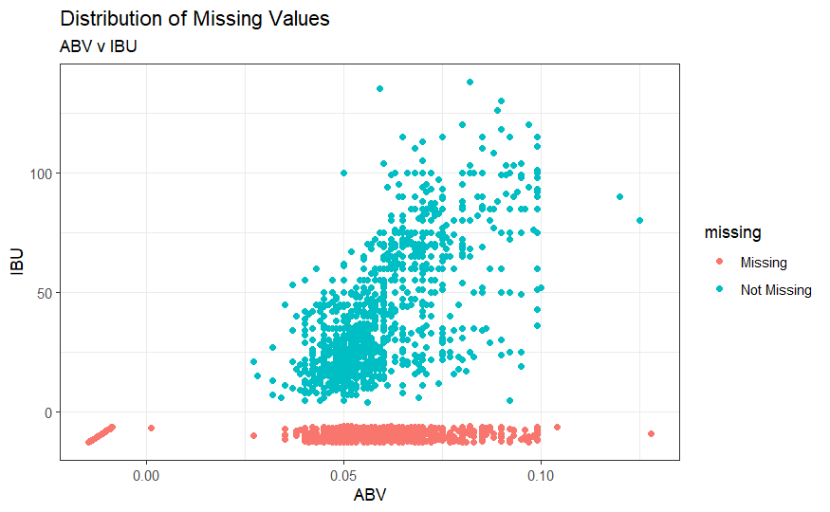
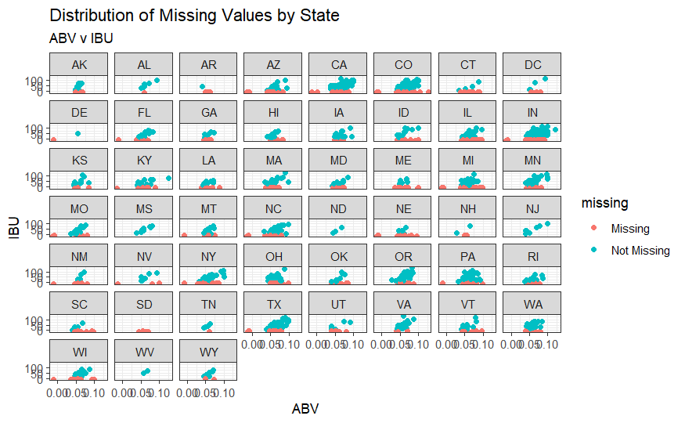
Missing Values Correlation by State

Slide 7
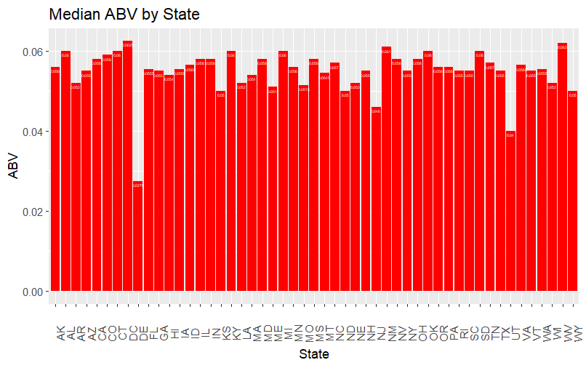
Median ABV by State
The state of DC has the highest median alcohol content at 0.0625

Slide 8
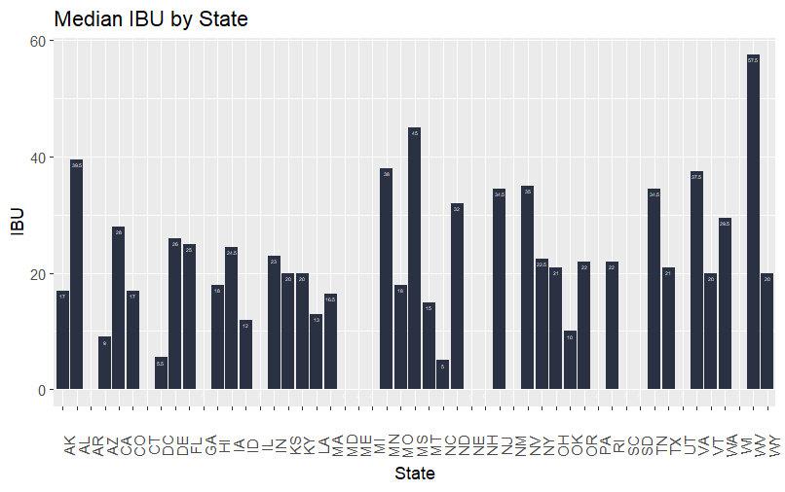
Median IBU by State
The state of West Virginia has the highest median IBU at 57.5

Slide 9
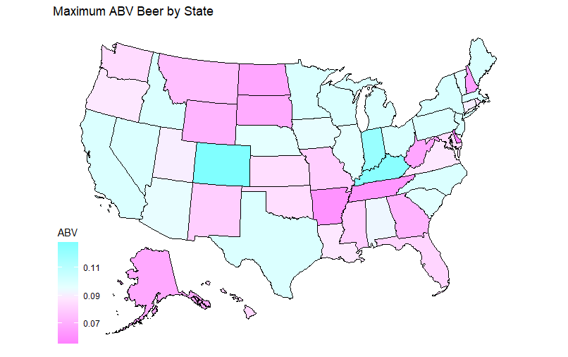
Most Alcoholic Beer - State
Beer | Type | Ounce | State | Max ABV
Lee Hill Series Vol. 5 - Belgian Style Quadrupel Ale | Quadrupel (Quad) | 12 OZ | Colorado | 0.128

Slide 10
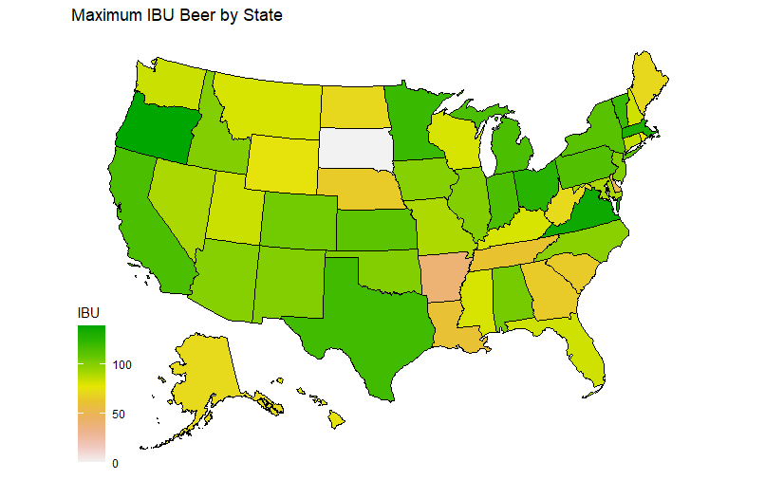
Most Bitter Beer - State
Beer | Type | Ounce | State | Max ABV
Bitter Bitch Imperial IPA | American Double/Imperial IPA | 12 OZ | Oregon | 138

Slide 11
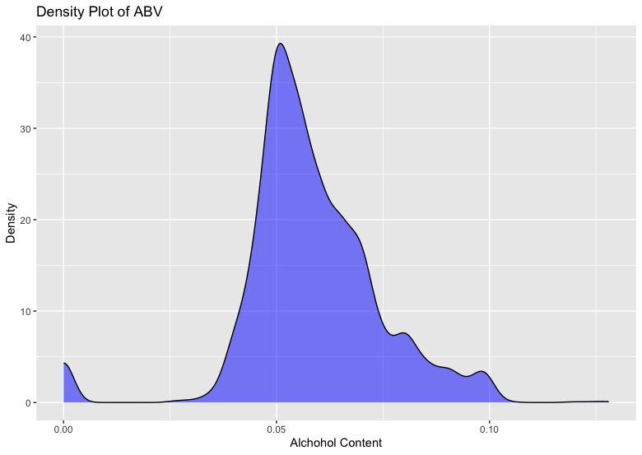
Summary Statistics and Distribution of the ABV variable
Mean | Median | Mode | Std Dev
0.05824 | 0.056 | 0.05 | 0.01637826
Min | 1st Qu. | 3rd Qu. | Max
0.027 | 0.05 | 0.067 | 0.128
This is a right skewed distribution
Mode<Median<Mean

Slide 12
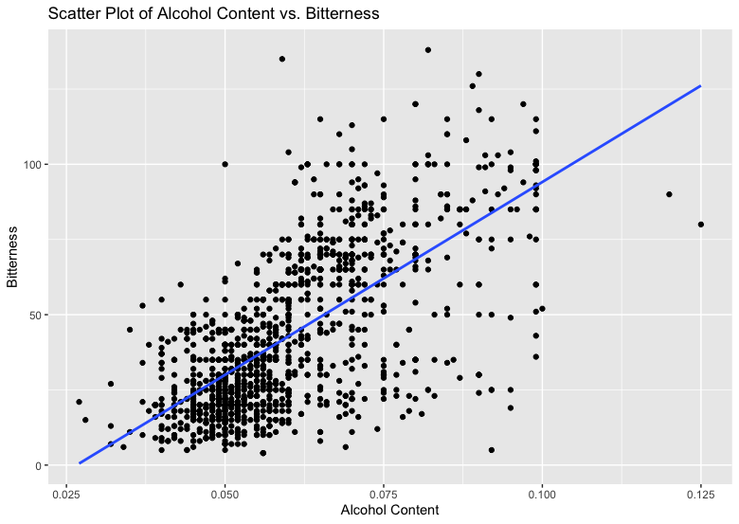
Relationship between Beer bitterness and its alcoholic content
Comments
The regression line has positive slope Correlation co-efficient between ABV and IBU variables is 0.67 A correlation coefficient of 0.67 indicates a moderately strong positive linear relationship between the two variables As the alcoholic content increases, bitterness of beer increase as well, but not perfectly.

Slide 13
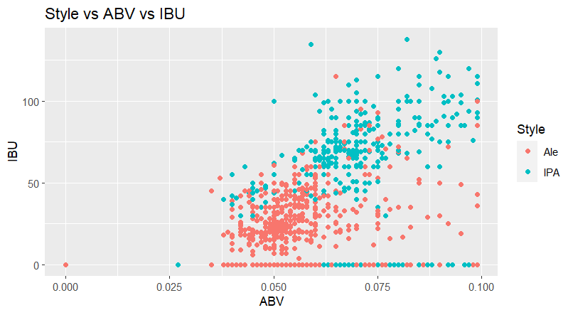
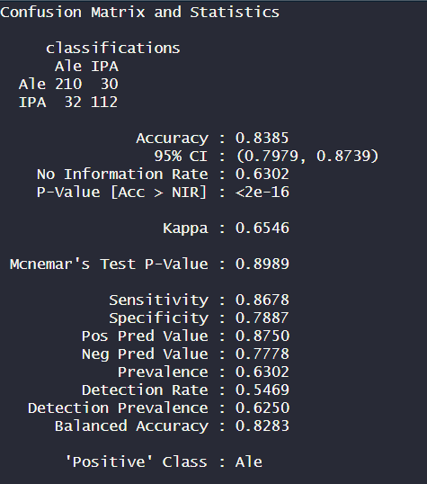
KNN and the Relationship between IPA v Other With Respect to ABV and IBU

Slide 14
Conclusion
State Analysis: Colorado Leading
Missing Values MCAR (Missing Completely at Random)
ABV & IBU Analysis
Summary Statistics
Evaluated Beers and Breweries data and the correlation between Types of beers with respect to ABV and IBU values
IPA v Ale
IPA Highest ABV and IBU values as opposed to Ales

